Slide 1
Capstone project
Mayank Bhandari

Slide 2
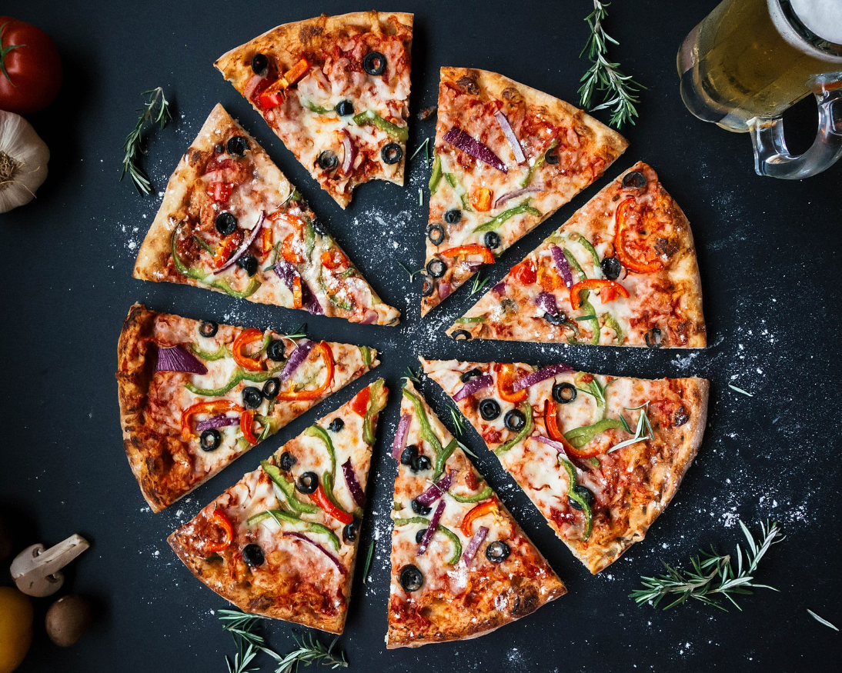
Introduction
Being fond of food, when it comes to find out a solution to a problem using data science, the first thing that comes to my mind is why not help my own community of foodies J, which eats and serves delicious food to all. This project can help people who want to open a restaurant like Burrito Place. In this project they can find the process to find the best location using different tools and data science.

Slide 3

Problem statement
This project will pupil to find the best location to open a Burrito Place in Ontario, Canada. Firstly, it is important to know each Borough to select the best with low competition and high potential clients.
Then, is important know the neighborhood and finally select the best location.

Slide 4


Data collection and methodology
As per data collection purpose, google maps api and foursquare will be used. Methodology is simple, in which we will use google api to obtain latitude and longitude values and then use foursquare api to get the venues of that location. We need to find out location with potential customers and less/least number of specific store present.

Slide 5
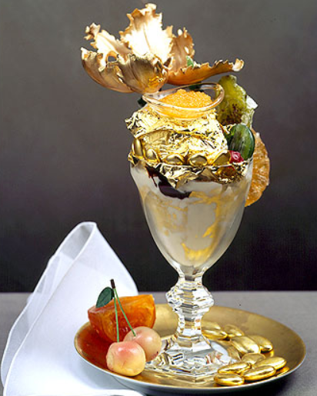
Result discussion and conclusion
For detailed result, please refer the notebook, which contains approach and result for the problem. The accuracy of the result totally depends upon the accuracy of data obtained from the above mentioned sources. I loved to work upon this project and will love to do such analysis again in future
The adjacent image shows my dream dessert. It’s the most expensive dessert in the world, which is clear why this is so ☺ ….

